Slide 1
Data Science: Definition, Working, Benefits & Applications, Data Science vs. Business Intelligence, The data science process, Role of a Data Scientist.
Unit III
Topics Covered:
Notes By:
Dr. Seema Gulati

Slide 2
What is Data Science?
Data Science is about data gathering, analysis and decision-making.
Data Science is about finding patterns in data, through analysis, and make future predictions.
By using Data Science, companies are able to make:
Better decisions (should we choose A or B)
Predictive analysis (what will happen next?)
Pattern discoveries (find pattern, or maybe hidden information in the data)

Slide 3
Definition of Data Science
Interdisciplinary field combining statistics, programming, and domain knowledge.
Extracts insights from structured (databases) & unstructured (text, images) data.

Slide 4
Key Components of Data Science
Statistics & Mathematics: Probability, regression, hypothesis testing.
Programming: Python, R, SQL for data manipulation.
Machine Learning (ML): Supervised, unsupervised, and reinforcement learning.
Big Data Technologies: Hadoop, Spark, and cloud computing (AWS, Google Cloud).
Data Visualization: Tools like Tableau, Matplotlib, and Power BI.

Slide 5
How Data Science Works
Step 1: Data Collection
Sources: Databases (SQL, NoSQL), APIs, web scraping, IoT sensors, social media.
Example: A retail company collects customer purchase history from its e-commerce platform.
Step 2: Data Cleaning & Preprocessing
Handling Missing Data: Imputation (mean/median) or removal.
Removing Duplicates & Outliers: Ensures data consistency.
Normalization & Scaling: Standardizes numerical data (e.g., Min-Max scaling).

Slide 6
Step 3: Exploratory Data Analysis (EDA)
Statistical Summaries: Mean, median, variance.
Visualizations: Histograms, scatter plots, heatmaps.
Correlation Analysis: Identifies relationships between variables.
Step 4: Feature Engineering
Feature Selection: Choosing relevant variables (e.g., RFE - Recursive Feature Elimination).
Feature Transformation: PCA (Principal Component Analysis), one-hot encoding.

Slide 7
Step 5: Model Building
Supervised Learning (Labeled Data):
Regression (Linear, Polynomial) → Predicting sales.
Classification (Logistic Regression, Decision Trees) → Spam detection.
Unsupervised Learning (Unlabeled Data):
Clustering (K-Means) → Customer segmentation.
Dimensionality Reduction (PCA) → Reducing noise in data.
Deep Learning (Neural Networks):
CNN (Image recognition), RNN (Time-series forecasting).

Slide 8
Step 6: Model Evaluation
Metrics:
Classification: Accuracy, Precision, Recall, F1-Score, ROC-AUC.
Regression: MSE (Mean Squared Error), RMSE, R².
Cross-Validation: K-Fold validation to prevent overfitting.
Step 7: Deployment & Monitoring
Deployment: Using Flask, FastAPI, or cloud services (AWS SageMaker).
Monitoring: Tracking model performance (A/B testing, drift detection).

Slide 9
Benefits of Data Science
For Businesses:
Improved Decision-Making: Data-driven strategies over gut feelings.
Cost Reduction: Optimizes operations (supply chain, inventory).
Customer Personalization: Recommender systems (Netflix, Amazon).
Fraud Detection: Anomaly detection in banking transactions.
For Healthcare:
Disease Prediction: AI models detect cancer from X-rays.
Drug Discovery: ML accelerates pharmaceutical research.
For Society:
Smart Cities: Traffic optimization, energy management.
Climate Science: Predictive models for weather forecasting.

Slide 10
Applications of Data Science
Industry | Use Cases
Finance | Credit scoring, algorithmic trading, fraud detection.
E-commerce | Dynamic pricing, recommendation engines.
Healthcare | Medical imaging, patient risk prediction.
Manufacturing | Predictive maintenance, defect detection.
Transportation | Self-driving cars, route optimization.
Entertainment | Content recommendation (Netflix, Spotify).
Social Media | Sentiment analysis, fake news detection.

Slide 11
Future of Data Science
AI & Automation: AutoML (Automated Machine Learning).
Edge AI: Real-time processing on IoT devices.
Ethical AI: Bias detection, explainable AI (XAI).
Quantum Computing: Faster complex computations.

Slide 12
Data Science vs. Business Intelligence (BI)
Aspect | Data Science | Business Intelligence (BI)
Definition | Uses advanced analytics, ML, and AI to predict future trends and solve complex problems. | Focuses on analyzing past and present data to generate reports and dashboards for decision-making.
Primary Goal | Predictive & Prescriptive (What will happen? How can we influence it?) | Descriptive & Diagnostic (What happened? Why did it happen?)
Data Types | Structured + Unstructured (text, images, videos) | Mostly structured (databases, spreadsheets)
Tools | Python, R, TensorFlow, Spark, Jupyter | Power BI, Tableau, SQL, Excel, SAP
Methods | Machine Learning, Deep Learning, NLP | SQL queries, OLAP, data visualization
Time Focus | Future-oriented | Historical & real-time
Complexity | High (requires coding, statistics, ML) | Moderate (drag-and-drop interfaces)
Users | Data scientists, ML engineers | Business analysts, executives
Output | Predictive models, AI solutions | Dashboards, KPIs, static reports
Example Use Case | Forecasting sales using AI algorithms | Monthly sales performance dashboard

Slide 13
Key Similarities
Data-Driven: Both rely on data for insights.
Visualization: Use tools like Tableau/Power BI.
Goal: Improve business decisions.

Slide 14
Choose BI if:
You need standardized reports.
Stakeholders want quick, visual insights.
Data is structured and historical.
Choose Data Science if:
You need predictions (e.g., customer churn).
Data includes unstructured sources (e.g., social media).
Problems require AI/ML (e.g., recommendation engines).

Slide 15
Role of a Data Scientist
Data scientists are the architects of data-driven decision-making, combining statistics, programming, and domain expertise to extract actionable insights from complex datasets. Below is a detailed breakdown of their role:

Slide 16
Core Responsibilities
A. Data Exploration & Analysis
Clean and preprocess raw data (handle missing values, outliers).
Perform Exploratory Data Analysis (EDA) using statistical methods and visualizations.
Identify patterns, trends, and anomalies in data.
B. Machine Learning & Predictive Modeling
Develop ML models (regression, classification, clustering) to solve business problems.
Train and fine-tune algorithms (e.g., Random Forests, Neural Networks).
Deploy models into production (e.g., using Flask, FastAPI, or cloud platforms).

Slide 17
Core Responsibilities
C. Data Storytelling & Visualization
Create dashboards (Power BI, Tableau) and reports for stakeholders.
Communicate insights clearly to non-technical audiences.
D. Big Data & Cloud Computing
Work with large datasets using tools like Spark, Hadoop, or cloud services (AWS, GCP).
Optimize data pipelines for scalability.
E. Business Impact
Collaborate with teams (marketing, finance, operations) to solve real-world problems.
Examples:
Optimizing supply chains.
Fraud detection in banking.
Personalized recommendations (Netflix, Amazon).

Slide 18
Data Processing
Definition
Data processing involves collecting, cleaning, transforming, and organizing raw data into a structured format suitable for analysis.

Slide 19
Stages of Data Processing
Data Collection
Gathering data from databases, APIs, sensors, surveys, logs, etc.
Methods: Web scraping, IoT devices, manual entry, automated feeds.
Data Cleaning
Handling missing values (imputation, deletion).
Removing duplicates and outliers.
Standardizing formats (dates, currencies, units).

Slide 20
Stages of Data Processing
Data Transformation
Normalization (scaling data to a standard range).
Aggregation (summarizing data, e.g., daily sales → monthly trends).
Encoding categorical data (one-hot encoding, label encoding).
Data Integration
Combining data from multiple sources.
Resolving inconsistencies (e.g., different naming conventions).

Slide 21
Stages of Data Processing
Data Reduction
Dimensionality reduction (PCA, t-SNE).
Sampling (selecting a representative subset).
Data Storage
Databases (SQL, NoSQL).
Data warehouses (Snowflake, BigQuery).
Data lakes (AWS S3, Hadoop HDFS).

Slide 22
Data Processing Techniques
Type | Description | Use Cases
Batch Processing | Processes large datasets at scheduled intervals. | Monthly financial reports, ETL pipelines.
Real-Time Processing | Processes data immediately as it arrives. | Fraud detection, live dashboards.
Stream Processing | Continuously processes data streams. | IoT sensor monitoring, social media feeds.
Distributed Processing | Uses multiple machines (Hadoop, Spark). | Big data analytics, machine learning.

Slide 23
Data Formatting
Data formatting involves cleaning and transforming raw data into a usable format. Pandas offers several functions for this purpose:
Handling missing values: Using fillna(), dropna(), or replace() to manage missing data.
Data type conversion: Employing astype() to change the data type of columns.
String manipulation: Utilizing functions like strip(), lower(), upper(), and replace() for cleaning text data.
Date and time formatting: Converting strings to datetime objects using to_datetime() and extracting components like year, month, and day.

Slide 24
Data Formatting Functions
Function/Method | Explanation | Example Usage
astype() | Converts a column to specified data type | df['col'].astype('int')
pd.to_datetime() | Converts string/object to datetime format | pd.to_datetime(df['date_col'])
fillna() | Replaces missing values (NaN) with specified value/method | df.fillna(0)
dropna() | Removes rows/columns with missing values | df.dropna()
str.upper()/ str.lower() | Converts strings to uppercase/lowercase | df['text'].str.upper()
str.strip() | Removes leading/trailing whitespace | df['text'].str.strip()
str.split() | Splits strings by delimiter | df['email'].str.split('@')
dt.year/dt.month | Extracts year/month from datetime | df['date'].dt.year
dt.strftime() | Formats datetime as string | df['date'].dt.strftime('%Y-%m')

Slide 25
Exploratory Data Analysis (EDA) Functions
Function/ Method | Explanation | Example Usage
describe() | Generates descriptive statistics (count, mean, std, etc.) | df.describe()
info() | Shows column data types and non-null counts | df.info()
value_counts() | Counts unique values in a column | df['dept'].value_counts()
corr() | Computes pairwise correlation between columns | df.corr()
corrwith() | Computes correlation with another Series/DataFrame | df.corrwith(df['target'])
plot() | Creates basic plots (hist, box, scatter, etc.) | df['age'].plot(kind='hist')

Slide 26
Data Filtering Functions
Function/ Method | Explanation | Example Usage
Boolean Indexing | Filters rows using conditional expressions | df[df['age'] > 30]
query() | Filters using SQL-like expression | df.query("age > 30 & salary < 100000")
isin() | Checks if values are contained in a list | df[df['dept'].isin(['IT','HR'])]
str.contains() | Filters rows where string contains substring | df[df['name'].str.contains('John')]
str.startswith()/ endswith() | Filters by string prefix/suffix | df[df['email'].str.endswith('.com')]
between() | Filters values within a range | df[df['date'].between('2023-01-01', '2023-12-31')]

Slide 27
Hierarchical Indexing (MultiIndex) Functions
Function/ Method | Explanation | Example Usage
set_index() | Converts columns to index levels | df.set_index(['dept','id'])
MultiIndex.from_arrays() | Creates MultiIndex from arrays | pd.MultiIndex.from_arrays([...])
loc[] | Accesses group by index label(s) | df_multi.loc['IT']
xs() | Cross-section: gets slice at particular level | df_multi.xs('HR', level='dept')
stack() | Pivots columns into index (wide → long) | df.stack()
unstack() | Pivots index levels into columns (long → wide) | df_multi.unstack()
groupby(level=) | Groups by specified index level | df_multi.groupby(level='dept').mean()

Slide 28
What Is Data Visualization?
Data visualization is the process of creating a visual representation of the information within a dataset.
Pie charts
Bar charts
Histograms
Gantt charts
Heat maps
Box-and-whisker plots
Waterfall charts
Area charts
Scatter plots
Infographics
Maps

Slide 29
Why Is Data Visualization Important?
Visually depicting data often makes it easier to understand and draw insights from.
As such, data visualization is an effective means of making data more accessible across an organization. This, in turn, can empower employees to back their actions using concrete information instead of relying on assumptions—resulting in more data-driven organizational processes.
Data visualization helps people see, interact with, and better understand data. Whether simple or complex, the right visualization can bring everyone on the same page, regardless of their level of expertise.

Slide 30
What Are Data Visualization Tools?
Data visualization is a process of turning data into visual formats like charts, graphs, maps, and dashboards. This is done to make complex data easier to understand and interpret. The main goals of data visualization include:
Simplifying complexity: Large datasets with numerous variables can be overwhelming. Visualization helps highlight key trends, patterns, and outliers.
Enhancing decision-making: By visually representing data, stakeholders can make informed decisions quickly based on clear, accessible insights.
Improving engagement: Visual representations are often more engaging and memorable compared to raw data presented in tables or text.

Slide 31
Common types of visualizations include:
Bar Charts: Useful for comparing quantities across different categories.
Line Charts: Ideal for showing trends over time.
Pie Charts: Used to show parts of a whole, like market share.
Scatter Plots: Show the relationship between two continuous variables.
Heatmaps: Used to show the intensity of data points in a 2D space.

Slide 32
Basic Visualization Tools
These tools are often user-friendly and ideal for beginners or for standard visualizations like bar charts, pie charts, and line graphs.

Slide 33
1. Microsoft Excel
Widely used for quick charts and graphs
Features include bar, line, scatter plots, and pie charts
Great for small datasets and reports
2. Google Sheets
Cloud-based alternative to Excel
Offers similar chart options
Easy sharing and collaboration

Slide 34
3. Tableau Public (Free Version)
Drag-and-drop interface
Interactive dashboards
Suitable for both beginners and intermediate users
4. Power BI (Basic Features)
Integrates well with Microsoft products
Offers real-time dashboard capabilities

Slide 35
Specialized Visualization Tools
These tools offer advanced analytics, interactivity, and support for large or complex datasets.
They're often used by data scientists, analysts, and developers.

Slide 36
1. Tableau (Professional)
Features: Tableau’s professional version provides even more powerful capabilities for handling large datasets, creating complex visualizations, and integrating data from multiple sources.
It supports sophisticated calculations, mapping, and real-time data analysis.
PROS:
Extremely powerful for business intelligence and complex visualizations.
High customization with a variety of charts, maps, and interactive features.
Can handle big data and real-time dashboards.
CONS:
Requires a subscription (expensive for individual users).
Steeper learning curve than basic tools.

Slide 37
2. Power BI (Advanced)
Features: The advanced version of Power BI offers features like custom visuals, AI capabilities, predictive modeling, and integration with advanced analytics tools like R and Python.
Pros:
Supports complex data models and transformations.
Real-time analytics and dashboards.
Strong integration with Azure, SQL databases, and other Microsoft tools.
Cons:
Learning curve due to advanced features.
The full version requires a paid subscription.

Slide 38
3. D3.js
Features: D3.js is a JavaScript library for creating interactive, web-based data visualizations.
It gives users complete control over their visualizations, allowing them to create anything from bar charts to complex data-driven animations.
Pros:
Complete flexibility and customization.
Excellent for interactive, web-based visualizations.
Large support community and extensive documentation.
Cons:
Requires knowledge of JavaScript.
Steep learning curve for beginners.

Slide 39
4. Plotly
Features: Plotly is a graphing library that supports interactive visualizations.
It can be used with Python, R, and JavaScript to build highly interactive charts that can be embedded into web applications or dashboards.
Pros:
Offers interactive charts that are highly customizable.
Supports Python, R, and JavaScript for flexibility.
Great for interactive dashboards and reports.
Cons:
Requires coding skills.
Full features are available with a paid version.

Slide 40
When to Use Basic vs Specialized Tools
Basic Tools: Best for quick visualizations, small to medium datasets, and individuals or teams who need simple, straightforward graphs and charts.
Examples: Excel, Google Sheets, Tableau Public, Power BI (basic).
Specialized Tools: Necessary for large datasets, advanced analytics, custom visualizations, and real-time data reporting. These tools often support integration with big data systems, advanced analytics (AI/ML), and complex interactivity.
Examples: Tableau (Professional), Power BI (Advanced), D3.js, Plotly, Looker, Qlik Sense.

Slide 41
Visualize Distributions With Seaborn
Built on top of Matplotlib, Seaborn is a well-known Python library for data visualization that offers a user-friendly interface for producing visually appealing and informative statistical graphics.
It is designed to work with Pandas data frames, making it easy to visualize and explore data quickly and effectively.
Seaborn offers a variety of powerful tools for visualizing data, including scatter plots, line plots, bar plots, heat maps, and many more.
It also provides support for advanced statistical analysis, such as regression analysis, distribution plots, and categorical plots.

Slide 42
Key Features of Seaborn:
Beautiful Default Styles – Seaborn comes with built-in themes and color palettes for professional-looking plots.
Statistical Visualization – It offers specialized functions for visualizing distributions, correlations, and regression models.
Integration with Pandas – Works seamlessly with DataFrame objects.
Easier Complex Plots – Simplifies the creation of complex plots like heatmaps, violin plots, and pair plots.
Built-in Datasets – Includes example datasets (e.g., tips, iris, titanic) for quick experimentation.

Slide 43
Common Seaborn Plots:
Plot Type | Function | Use Case
Line Plot | sns.lineplot() | Trends over time
Bar Plot | sns.barplot() | Categorical comparisons
Histogram | sns.histplot() | Distribution of numerical data
Box Plot | sns.boxplot() | Summary statistics & outliers
Violin Plot | sns.violinplot() | Distribution + density
Scatter Plot | sns.scatterplot() | Relationship between two variables
Heatmap | sns.heatmap() | Matrix data & correlations
Pair Plot | sns.pairplot() | Multiple pairwise distributions
Regression Plot | sns.regplot() | Linear relationships

Slide 44
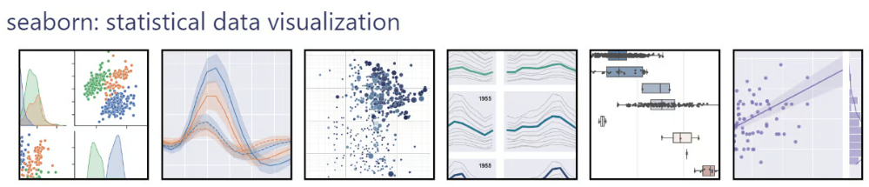

Slide 45
Seaborn Installation
Install Seaborn: !pip install seaborn
Import Matplotlib: import matplotlib.pyplot as plt
Import Seaborn: import seaborn as sns
Example:
import seaborn as sns
import matplotlib.pyplot as plt
tips = sns.load_dataset("tips") # Load a built-in dataset
sns.regplot(x="total_bill", y="tip", data=tips)# Create a scatter plot with regression line
plt.show() # Show the plot
Notes:
sns.load_dataset("tips") – Loads the tips dataset (a built-in dataset in Seaborn).
This dataset contains information about restaurant bills and tips, including:
total_bill (total cost of the meal)
tip (tip amount)
sex (gender of the payer)
day (day of the week)
time (lunch/dinner)
size (number of people in the group)
sns.regplot() – Creates a scatter plot + linear regression line.
x="total_bill" – The column from tips to plot on the x-axis.
y="tip" – The column from tips to plot on the y-axis.
data=tips – Specifies the DataFrame to use.

Slide 46
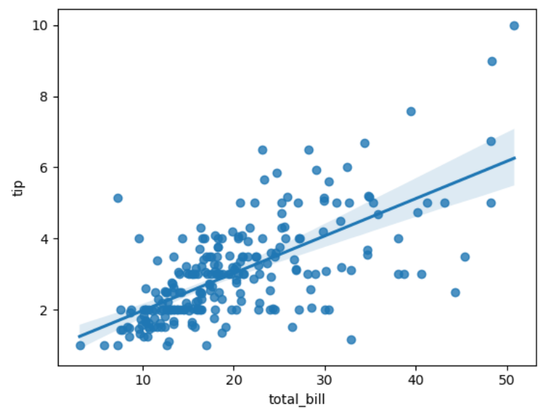

Slide 47
sns.set_style("darkgrid") # Set style and palette
sns.set_palette("pastel")
sns.boxplot(x="day", y="total_bill", data=tips, hue="sex") # Create a boxplot
plt.title("Total Bill by Day and Gender") # Add title and labels
plt.xlabel("Day of the Week")
plt.ylabel("Total Bill ($)")
plt.show()
Notes:
sns.set_style("darkgrid")
Sets the background style of the plot to "darkgrid" (a dark background with grid lines).
Other options: "white", "whitegrid", "dark", "ticks".
sns.set_palette("pastel")
Sets the color palette to "pastel" (soft, muted colors).
Other options: "deep", "muted", "bright", "dark", or custom lists (e.g., ["#FF5733", "#33FF57"]).
sns.boxplot() – Creates a boxplot to show distributions of numerical data (total_bill) across categories (day and sex).
x="day": Categories on the x-axis (days of the week: Thur, Fri, Sat, Sun).
y="total_bill": Numerical values on the y-axis (restaurant bill amounts).
data=tips: Specifies the DataFrame to use.
hue="sex": Splits boxes by gender (Male/Female) for side-by-side comparison.
Box: Interquartile range (IQR, middle 50% of data).
Line inside box: Median value.
Whiskers: Range of non-outlier data (typically 1.5× IQR).
Dots: Outliers.
plt.title(): Adds a title to the plot.
plt.xlabel() / plt.ylabel(): Labels the x-axis and y-axis.
Renders the plot in a window (required in scripts or non-Jupyter environments).

Slide 48
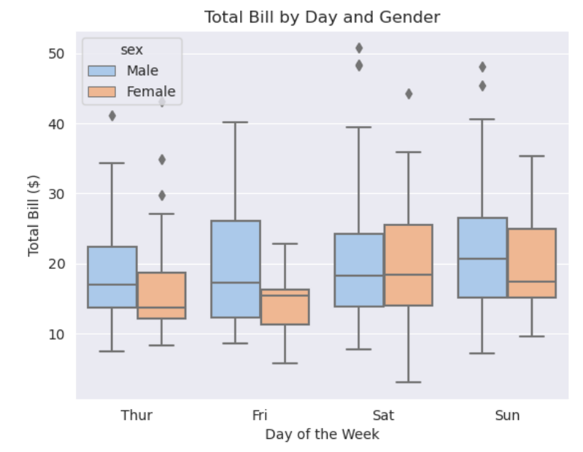

Slide 49
END

